Slide 1


Oliver Lin, David Rider, Monami Mukherjee, Jonathan Ting, Kyle Guillen, Justin Shadbehr
Notes:
Oliver

Slide 2
Index
Introduction
Data
Analytics and Visualizations
The “Perfect” Movie - 2084

Slide 3
Our Team
We are Whatever’s-Popular Studio, a collective focused on using past data to provide insight into profitability and popularity in different components of film, in order to help production studios with decision making.
Notes:
We are…
Today we are pitching our analytically perfect movie, 2048, to Netflix

Slide 4
Data
1960 - 2015
3823 movies
6775 actors
4802 keywords
Notes:
Our analytic and visualization is based on data we collected from tmdb. After proper data cleaning, our data set consists of 3823 movies, 6775 actos and 4802 keywords from year 1960 to 2015.

Slide 5
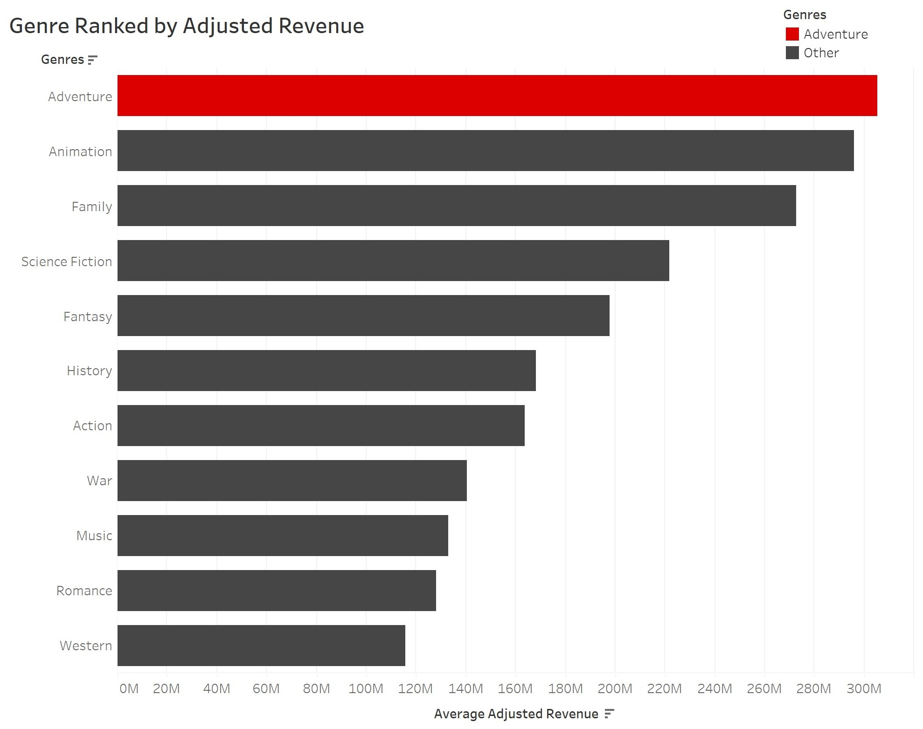
Genre Ranked by Adjusted Revenue
Notes:
Jonathan

Slide 6
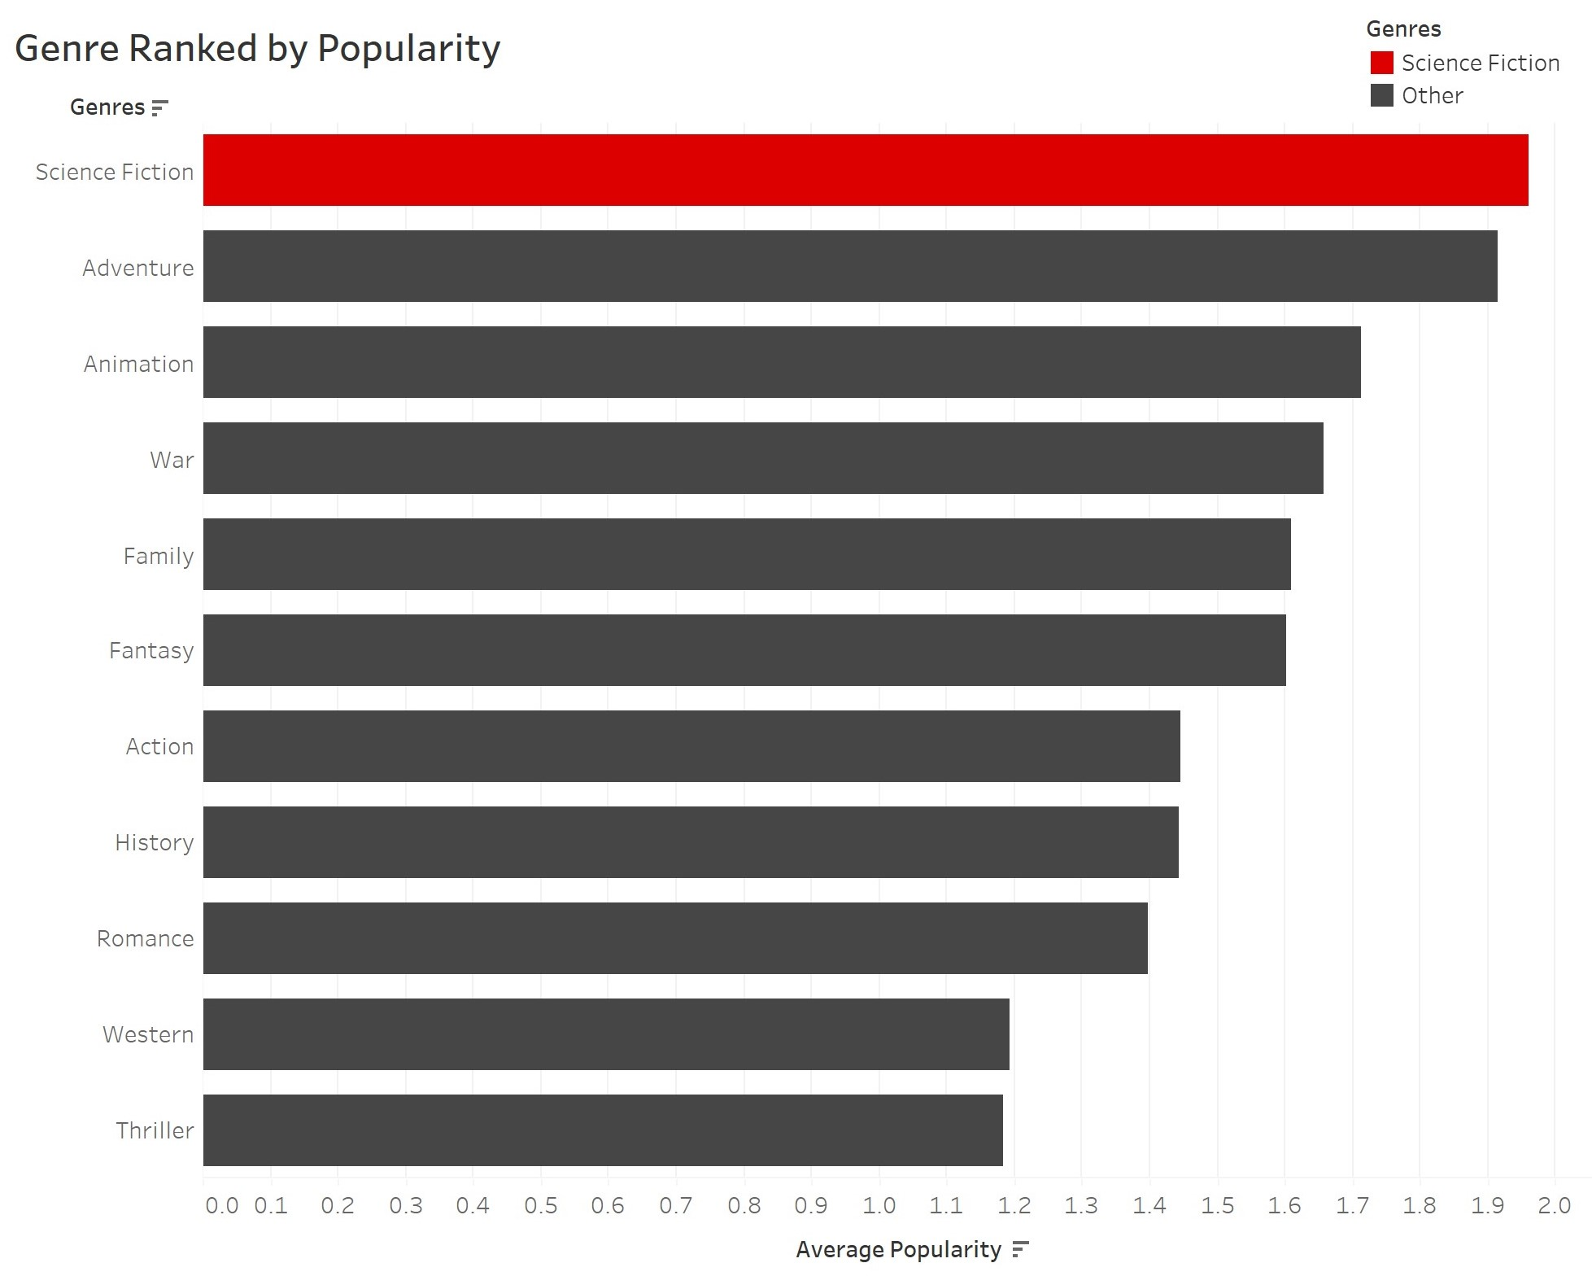
Science Fiction and Adventure are Best
Notes:
Jonathan

Slide 7
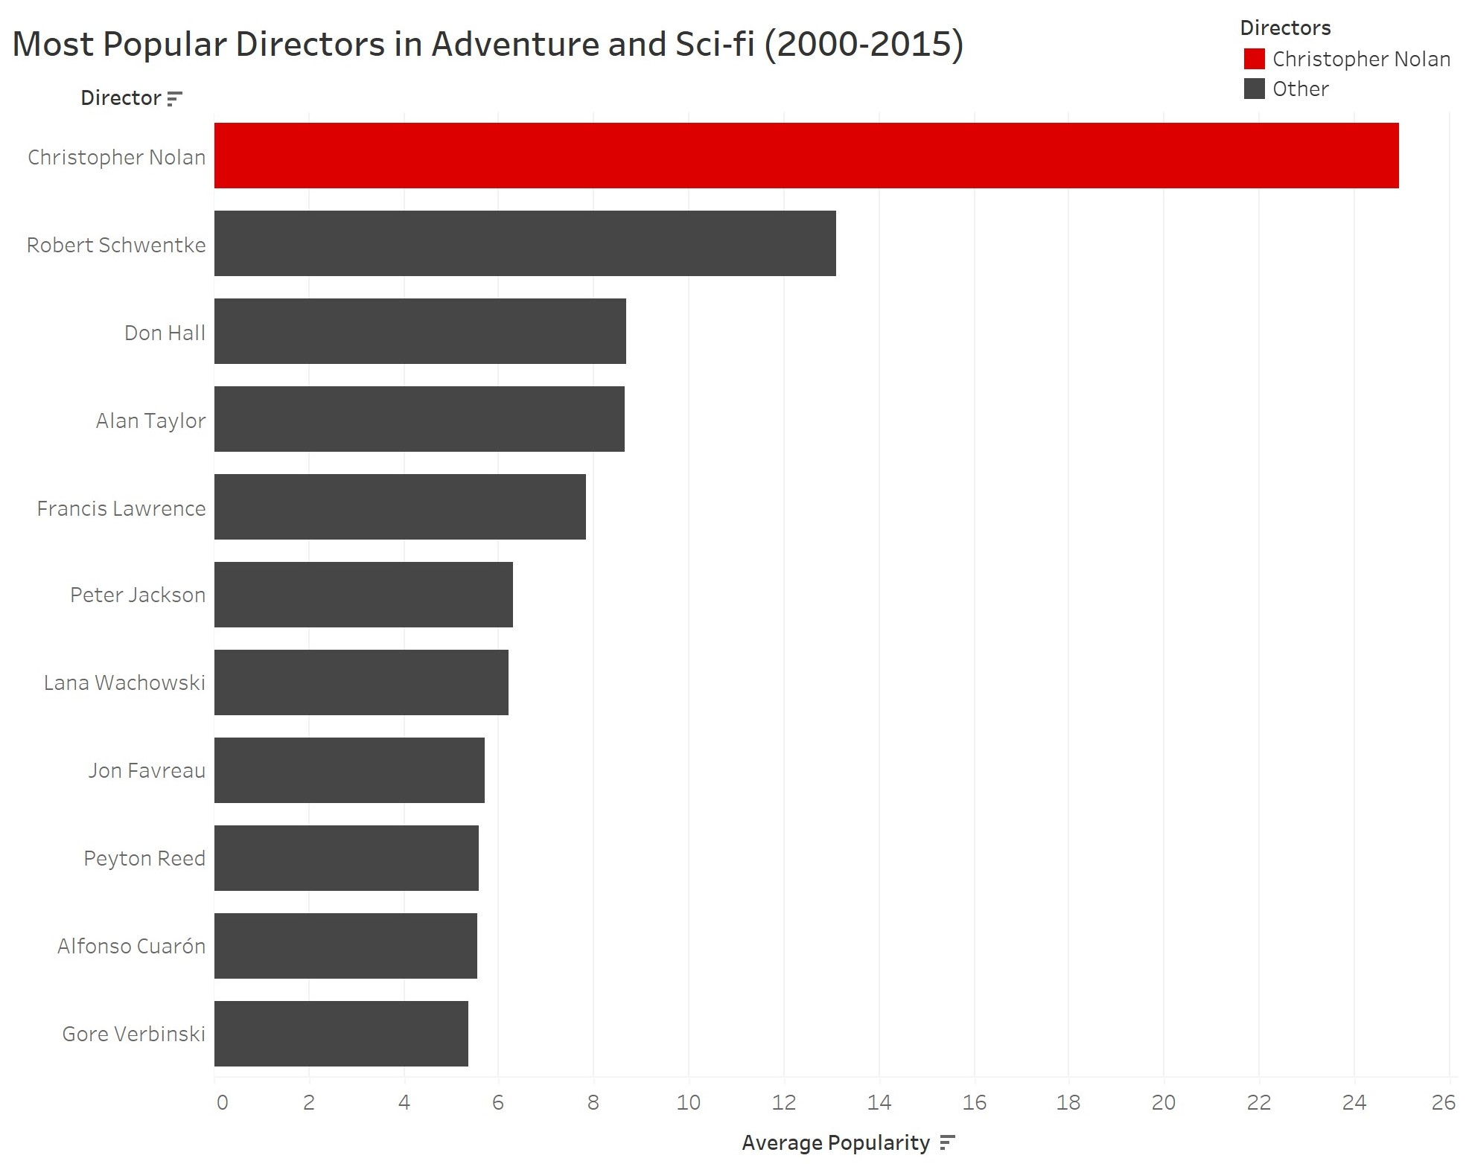
Christopher Nolan vs the World
Notes:
Jonathan

Slide 8
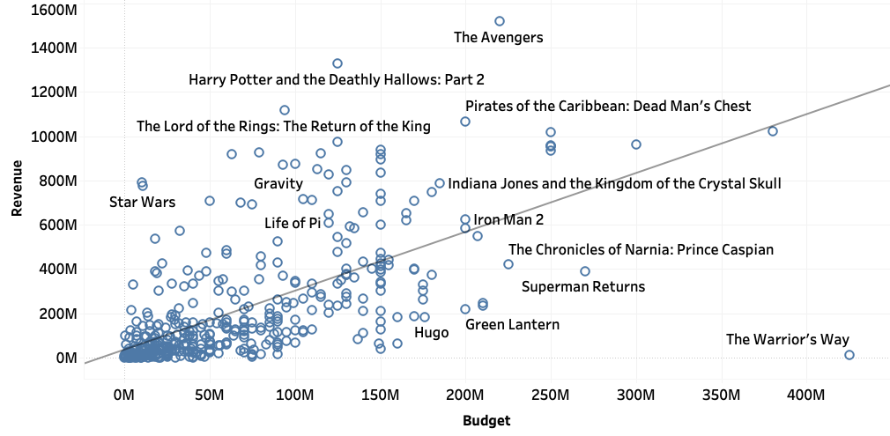
Generally, higher budgets result in higher revenue
Notes:
Kyle

Slide 9
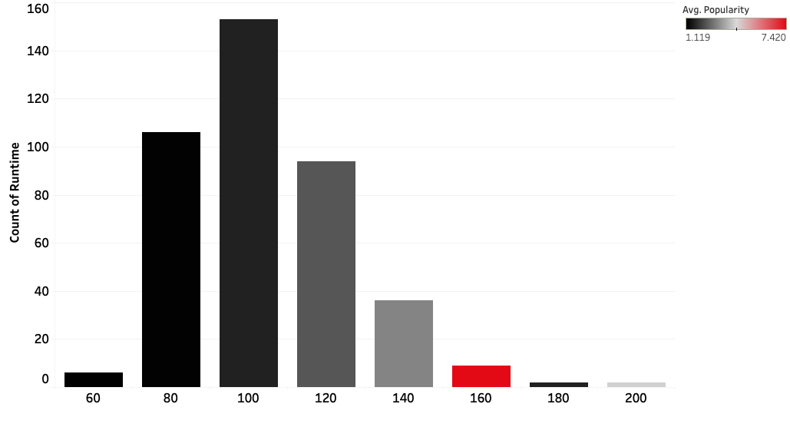
Most movies run about 80 to 100 minutes, however, the most popular movies are between 140 and 160 minutes
Notes:
Kyle

Slide 10
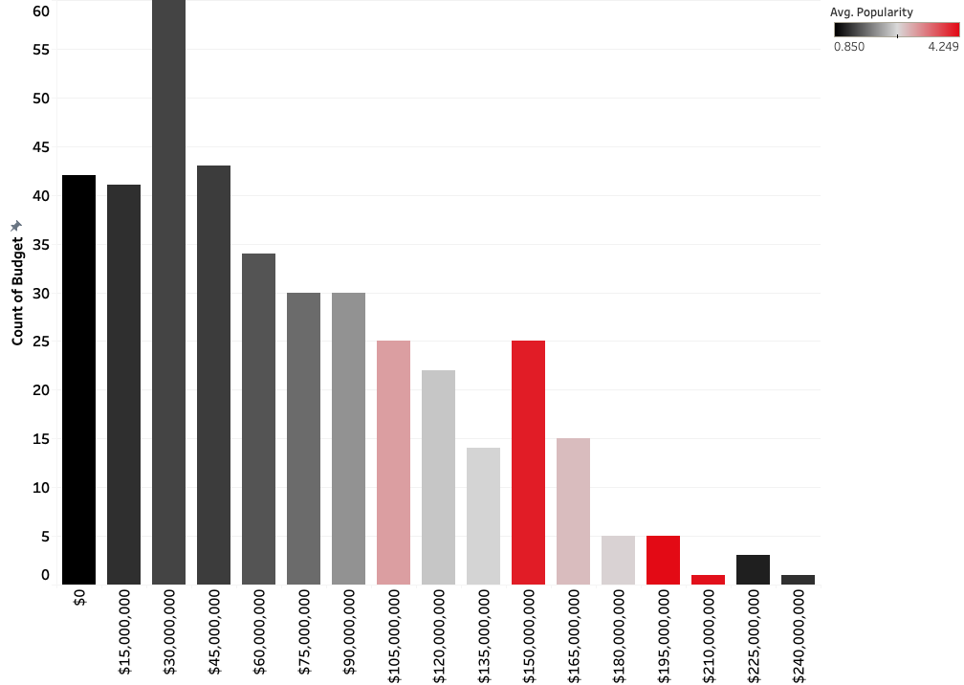
Majority of movie budgets run between $15MM and $45MM, the most popular movies tend to have budgets above $150MM
Notes:
Kyle

Slide 11
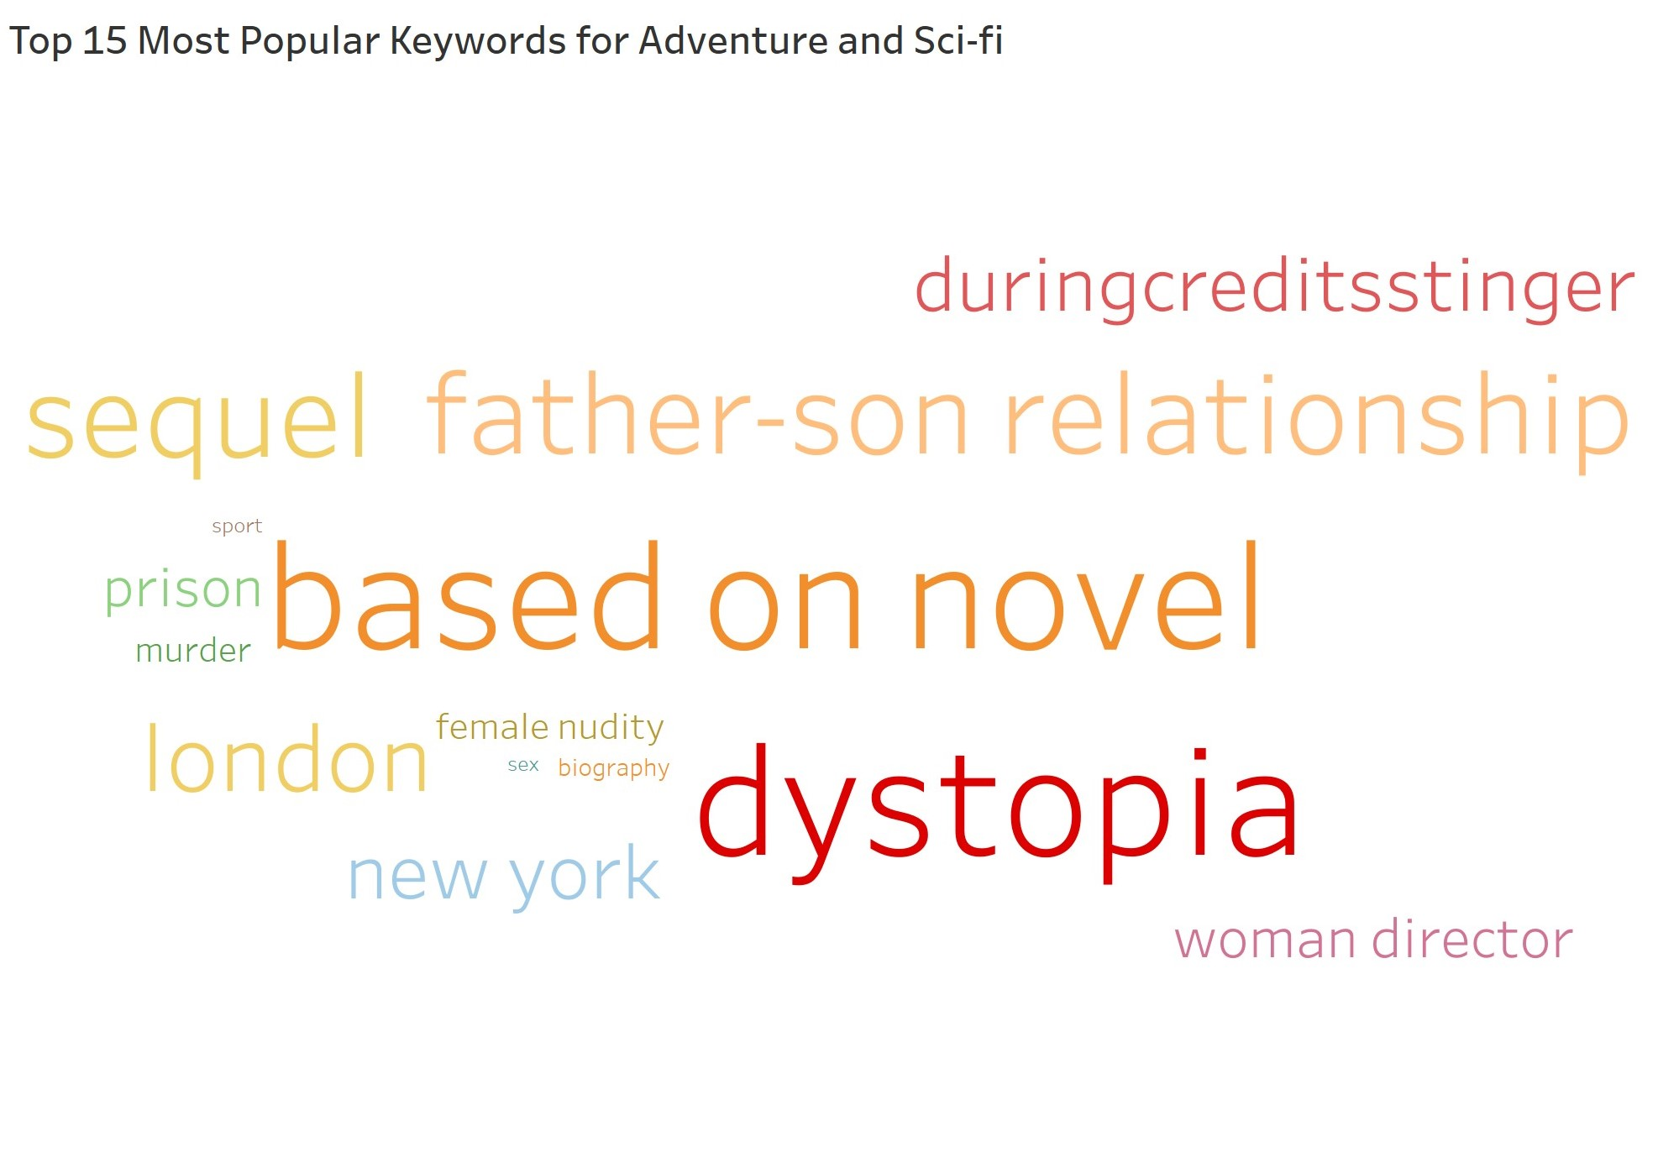
Notes:
Justin

Slide 12
Based on our Analysis and some creative input, here is the next “Perfect” Movie
Notes:
Justin

Slide 13
A film adaptation of George Orwell’s classic social sci-fi novel, 1984.
Notes:
Justin

Slide 14

Netflix, January 2023
Notes:
Justin

Slide 15
Big Brother is always watching.
Notes:
Introduce the logline-Monami

Slide 16
Production
Director: Christopher Nolan
Producer: Denis Villeneuve
Executive Producer: Jonathan Nolan
Casting Directors: Allison Jones, Bernard Telsey
Notes:
Monami
Mention production team and their background
i.e . Christopher Nolan will be directing the film. Nolan is known for his direction of both science fiction and action movies such as Inception, Interstellar and The Dark Knight.
-Denis Villeneuve sci-fi producer known for his work producing Arrival, Blade Runner 2049 and most recently, his newest sci-fi film Dune. Villeneuve’s recent undertaking of the project Dune has shown us his skill in adapting novels into screenplays

Slide 17
Casting
Winston Smith: Casey Affleck
Julia: Anne Hathaway
O’Brien: Matthew McConaughey
Mr. Charrington: Michael Caine
Notes:
Introduce the cast -Monami

Slide 18
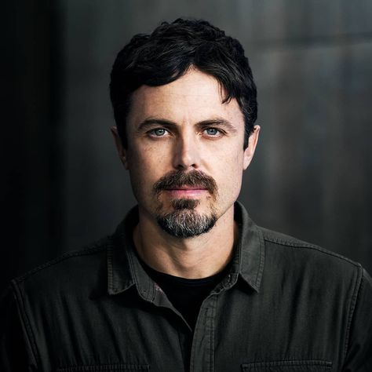
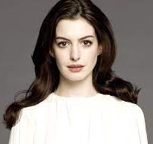
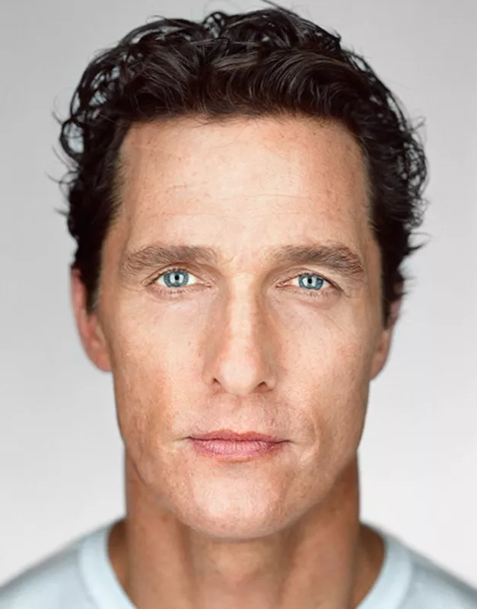
Winston Smith
Julia
O’Brien
Notes:
Monami

Slide 19
Logistics
Runtime: Production Starts: Production Ends:
Rough Release Date:
145 Minutes
April 2022
November 2022
January 2023
Notes:
Monami

Slide 20
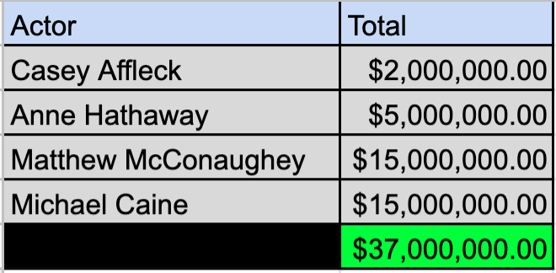
Working Budget (Talent) - $37,000,000.00
Notes:
David
Make things slightly more realistic - budget
Based off the talent we want - 37 million
Recent base offerings (compensation based on performance)

Slide 21
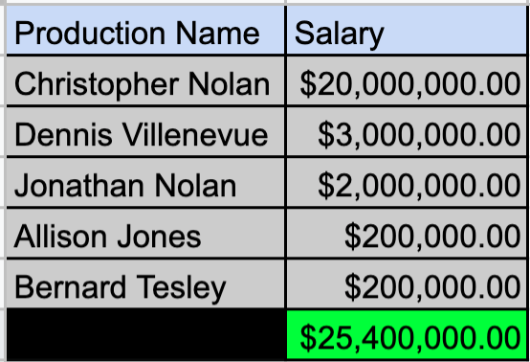
Working Budget (Production) - $25,400,000.00
Notes:
David
Production base salaries
Based off research for christopher nolan and dennis villenevue
Casting Directors - normal CD base pay

Slide 22
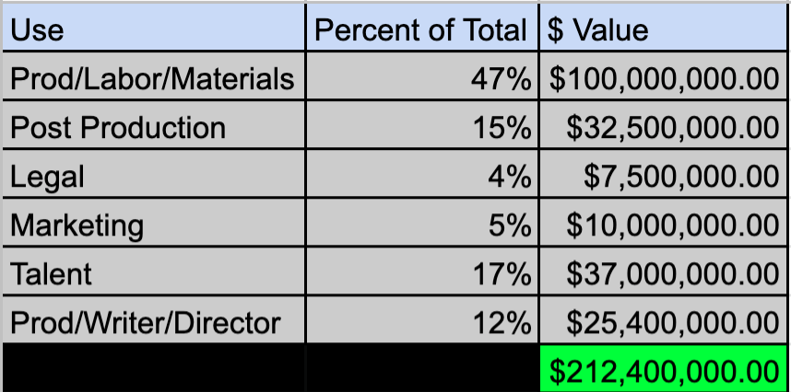
Final Working Budget - $212,400,000.00
Notes:
David
Total budget will look like
Similar approximation to other films

Slide 23
Netflix, January 2023
Notes:
Anyone

Slide 24
Reflection
Data Collection
Big Idea
Storyboarding
5 C’s

Slide 25
Thank you!

